Slide 1




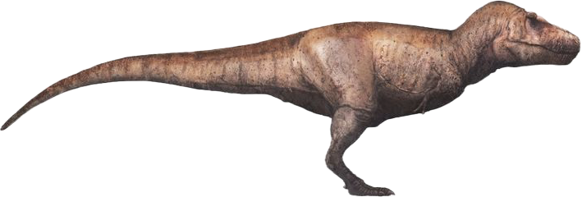
How good is TESS at finding long period exoplanets?
1
2
Rodel et al (2024)
Toby Rodel¹, Dan Bayliss², Sam Gill², Christopher¹ Watson, Yoshi Eschen², Faith Hawthorn2 (She’s looking for a job – give her one pls)
I hope you all like histograms... If not, I have hidden one dinosaur on every slide, if you can tell me what all of them are called; I’ll buy you a beverage.
Notes:
Introduce yourself, thank collaborators and shout out the paper. And introduce the dino minigame of course.

Slide 2
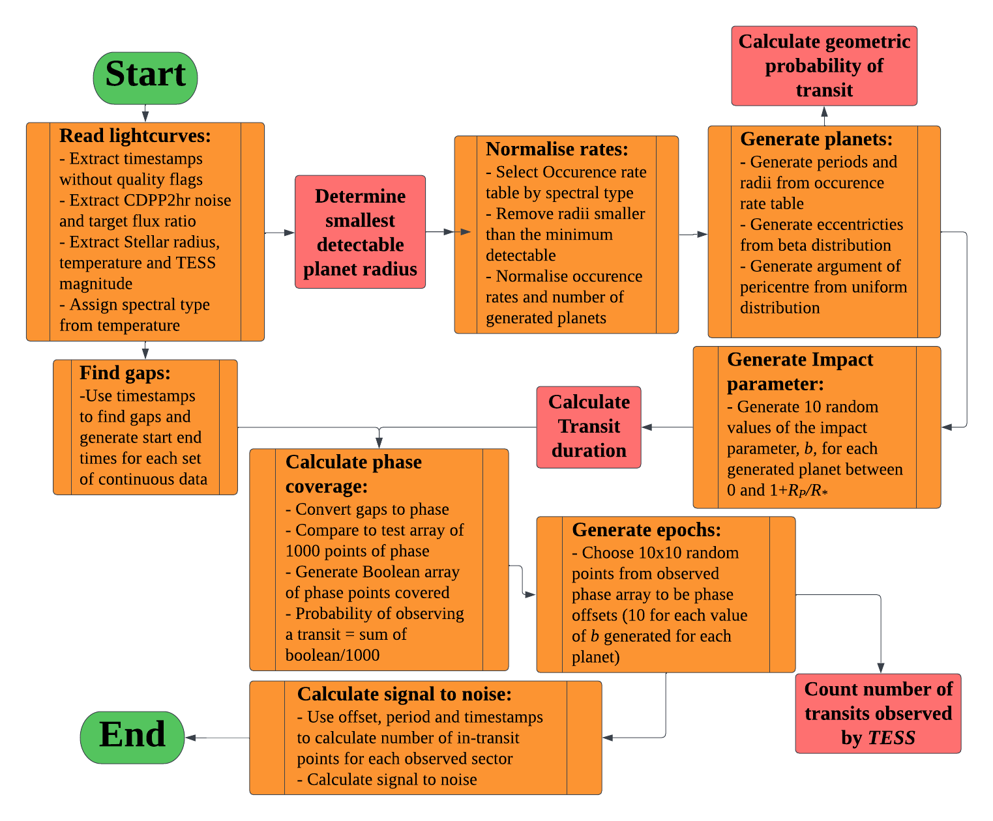

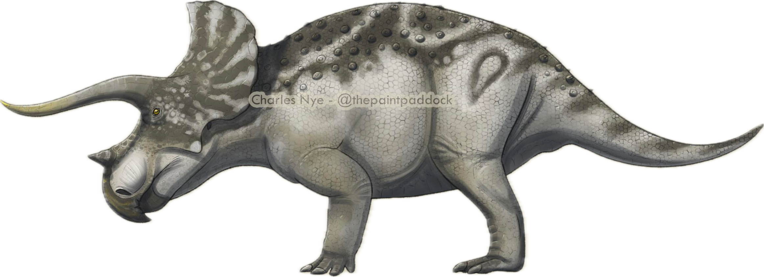
What is TIaRA?
The Transit Investigation and Recoverability Application
Fig 1: A Tiara
Fig 2: The TIaRA pipeline
Notes:
Briefly introduce the rationale, long period planets are expensive to follow up. Knowing how many there are helps guide our followup efforts (and looks good on panels).
We take lightcurve timestamps, noise and contamination values, generate transiting planet signals and calculate signal to noise

Slide 3
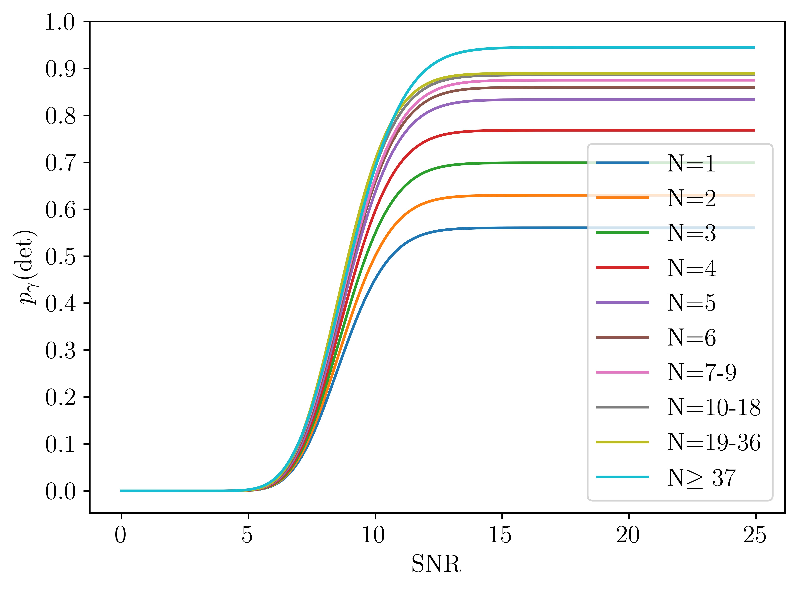
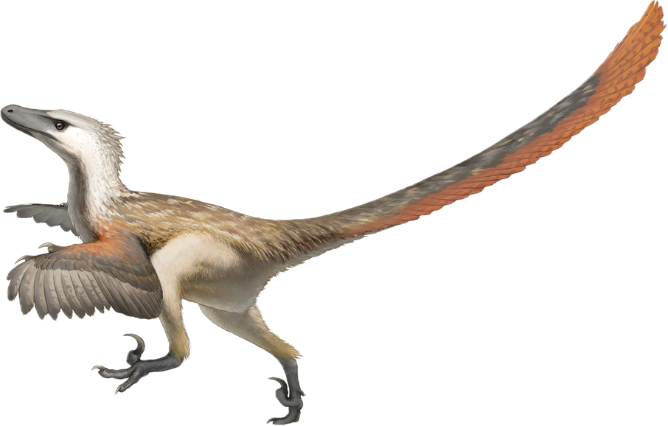
Christiansen et al. (2017), Hsu et al. (2019), Kunimoto et al. (2022)
Notes:
Link back to earlier discussion on SNR thresholds, for demographics we need to define a detection more rigourously. Use the Kepler gamma CDF with N=2 and N=1 coefficients extrapolated.

Slide 4
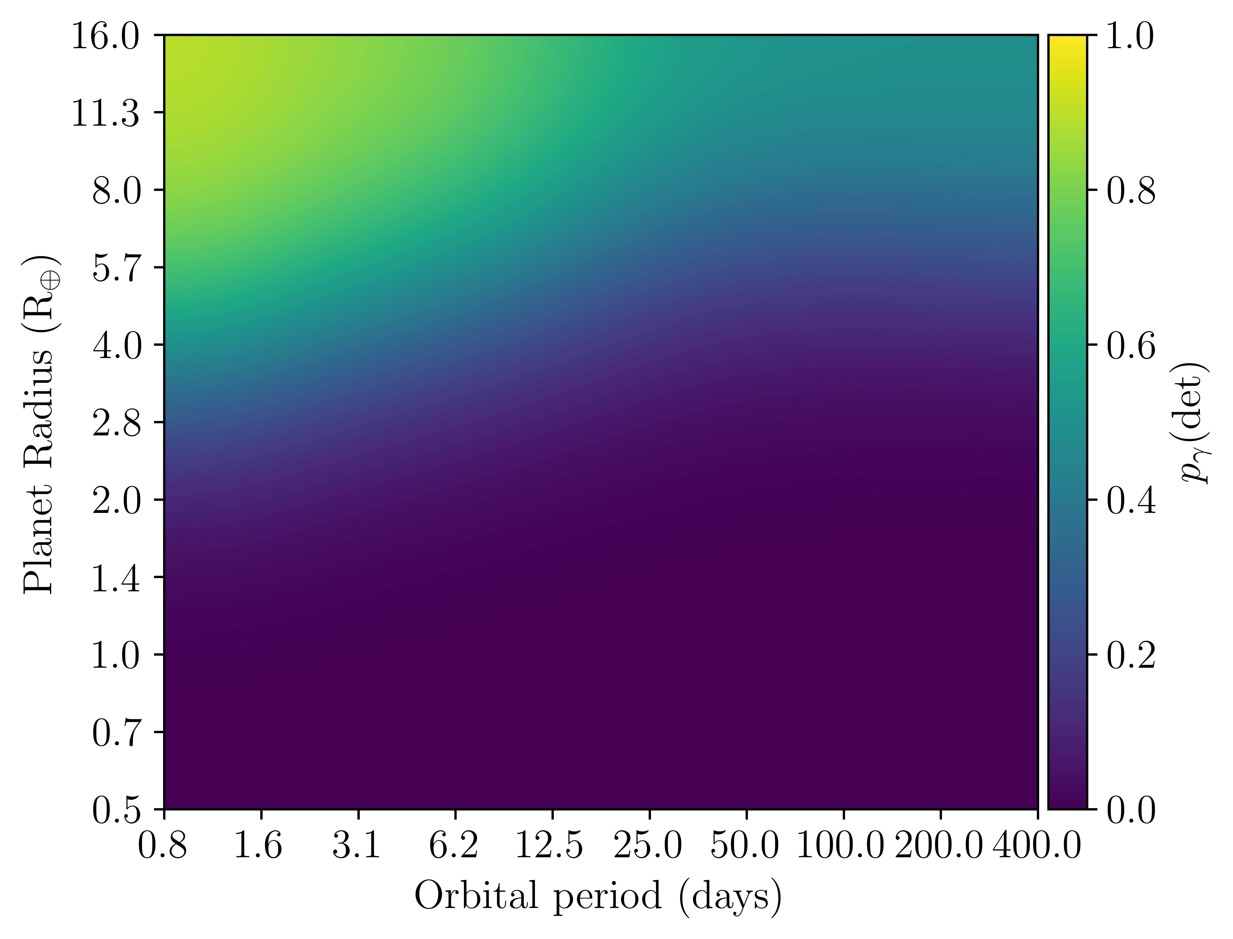
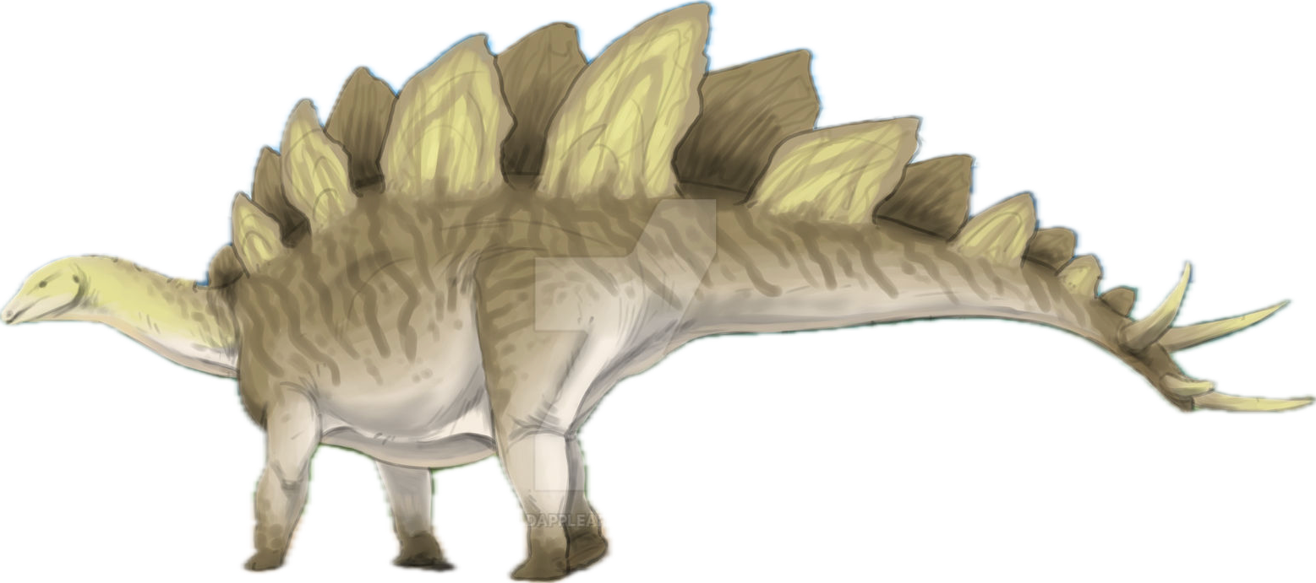
Notes:
Start off with basic probability of detection. Don’t draw attention to bimodality but explain if someone asks. (It’s duration of transit dominating over N transits due to monos)

Slide 5
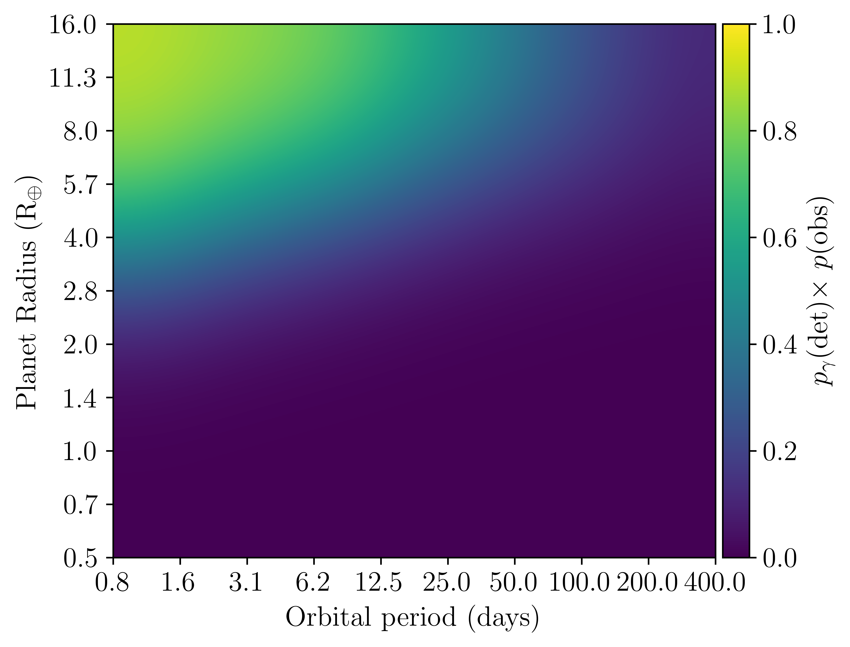
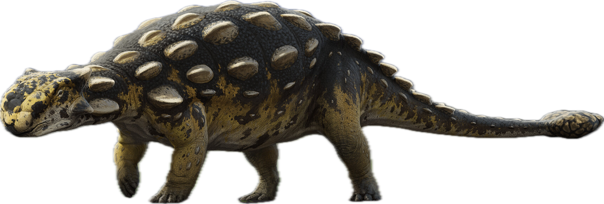
Notes:
Then implement window function

Slide 6
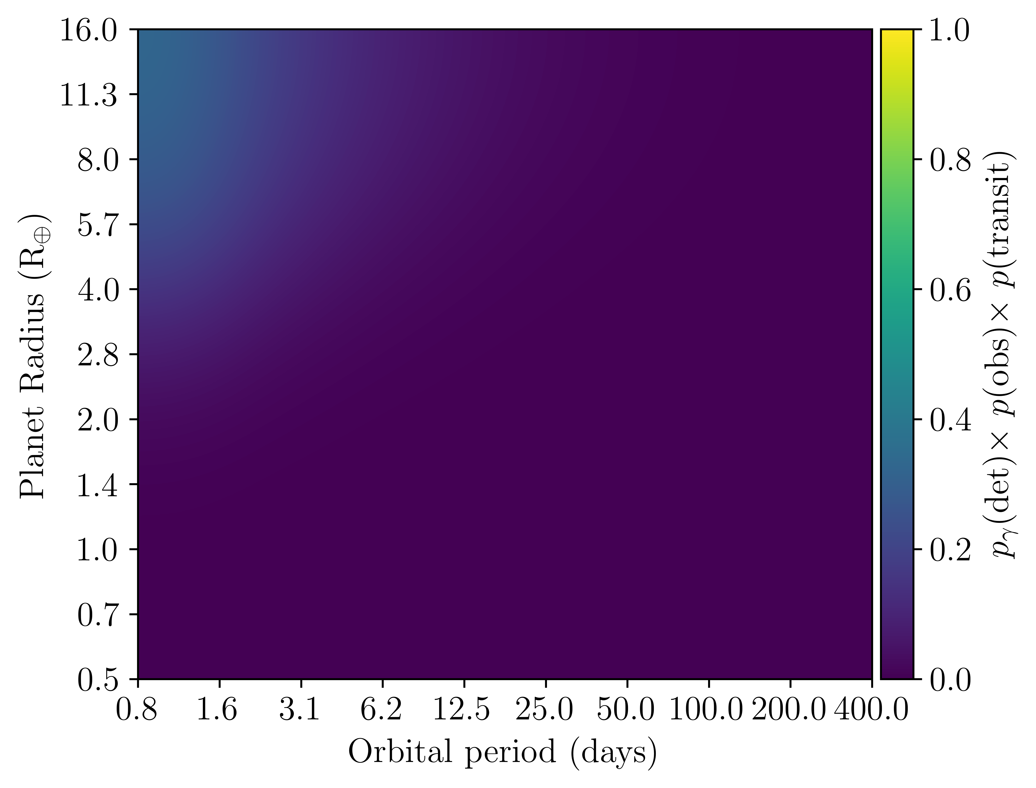
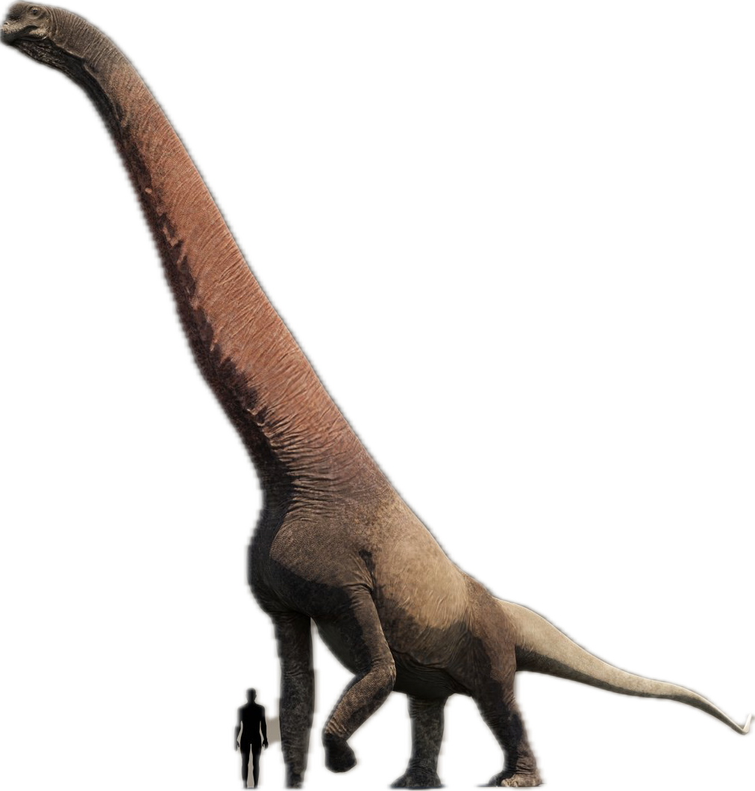
Notes:
And finally geometric probability

Slide 7
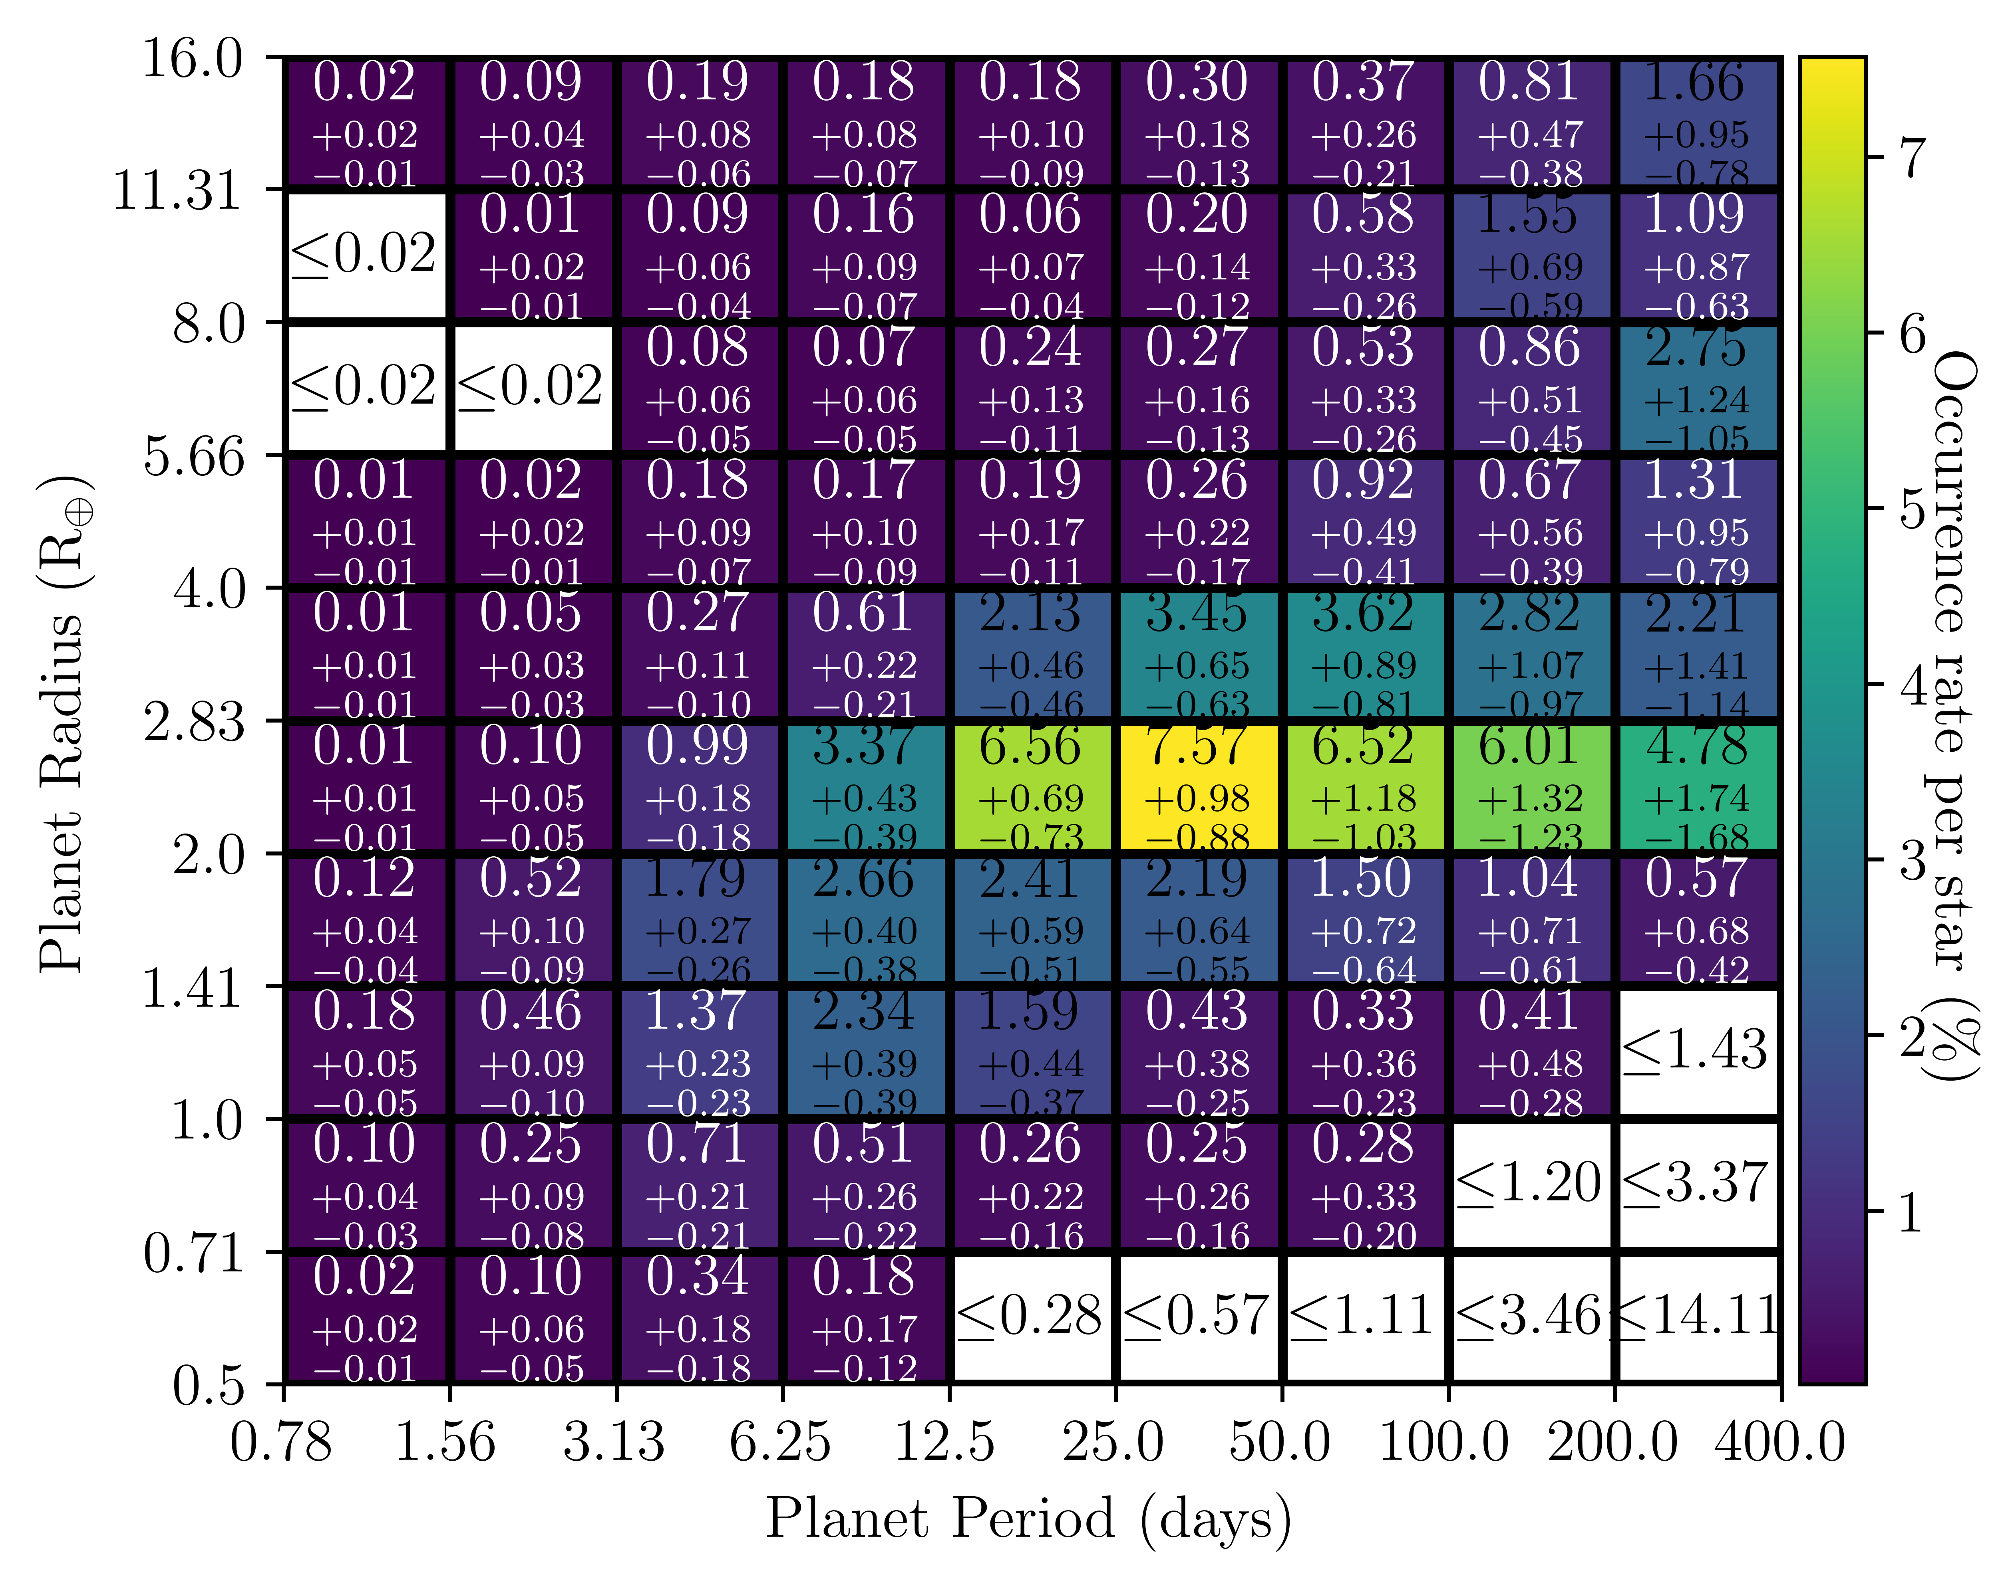
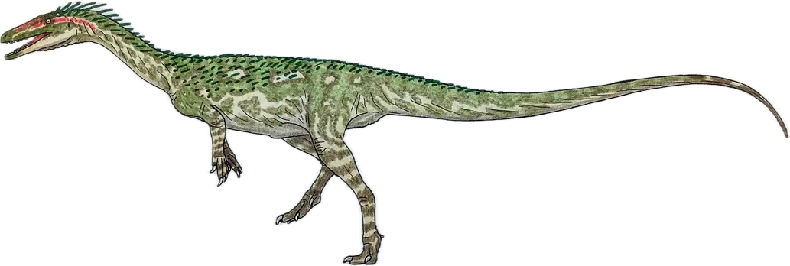
Kunimoto et al. (2020), Dressing and Charbonneau (2013,2015)
Notes:
Multiply final map by occurrence rate grids multiplied by stellar population. This is a combined FGK grid but we treat A, F, G, K and M stars separately in reality.

Slide 8
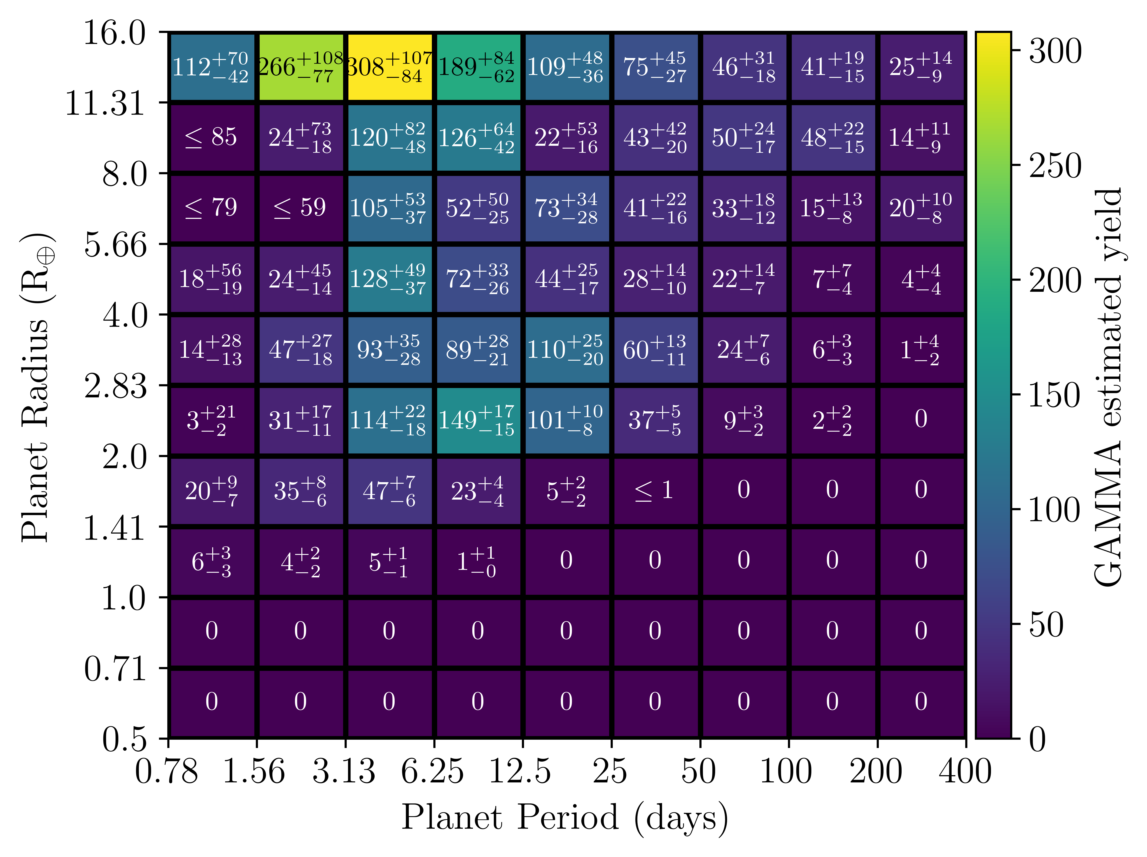
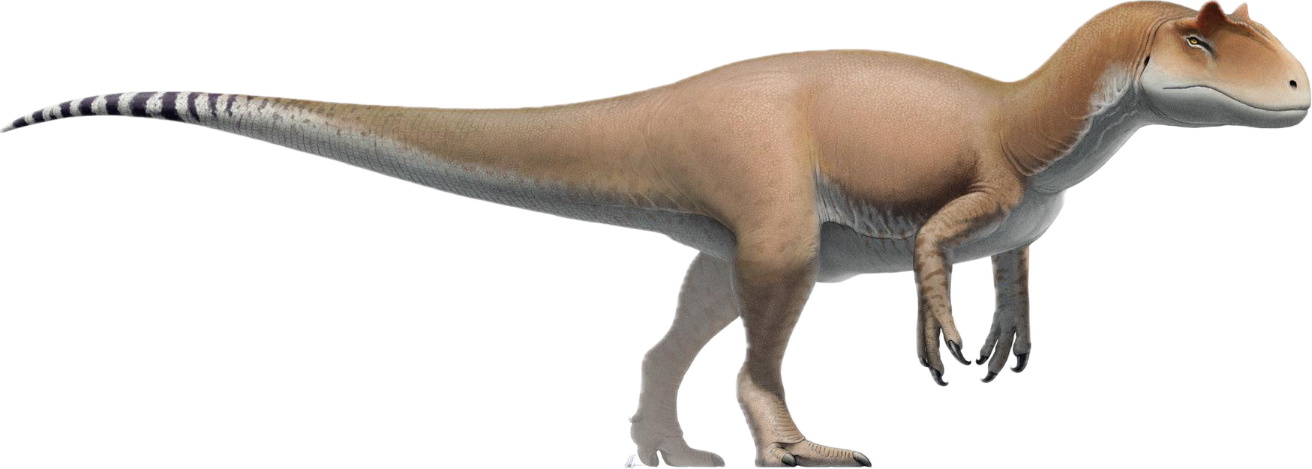
Years 1, 3 and 5
Rodel et al (In prep)
Notes:
Final predicted yield grid for TESS-SPOC years 1, 3 and 5 southern AFGKM stars. Don’t linger here – say trends become clearer when we condense to period.

Slide 9
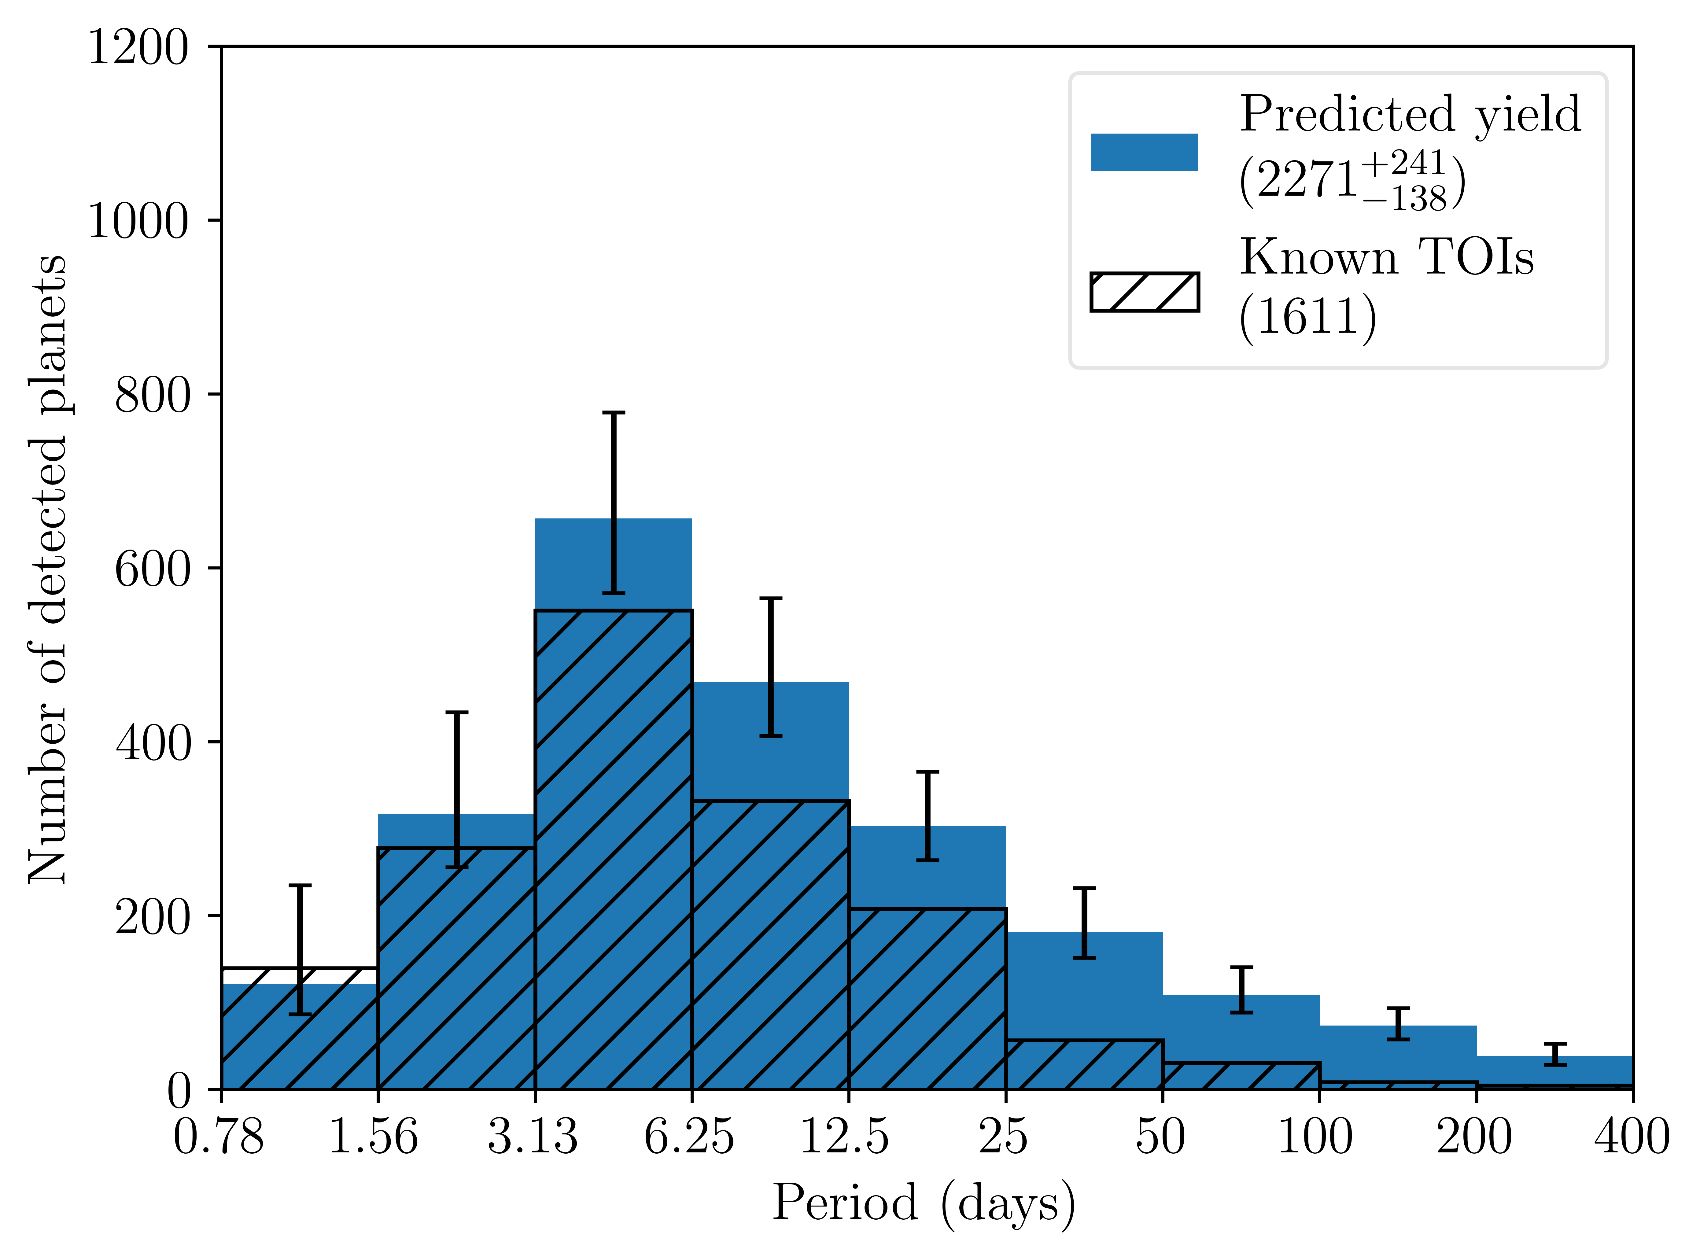
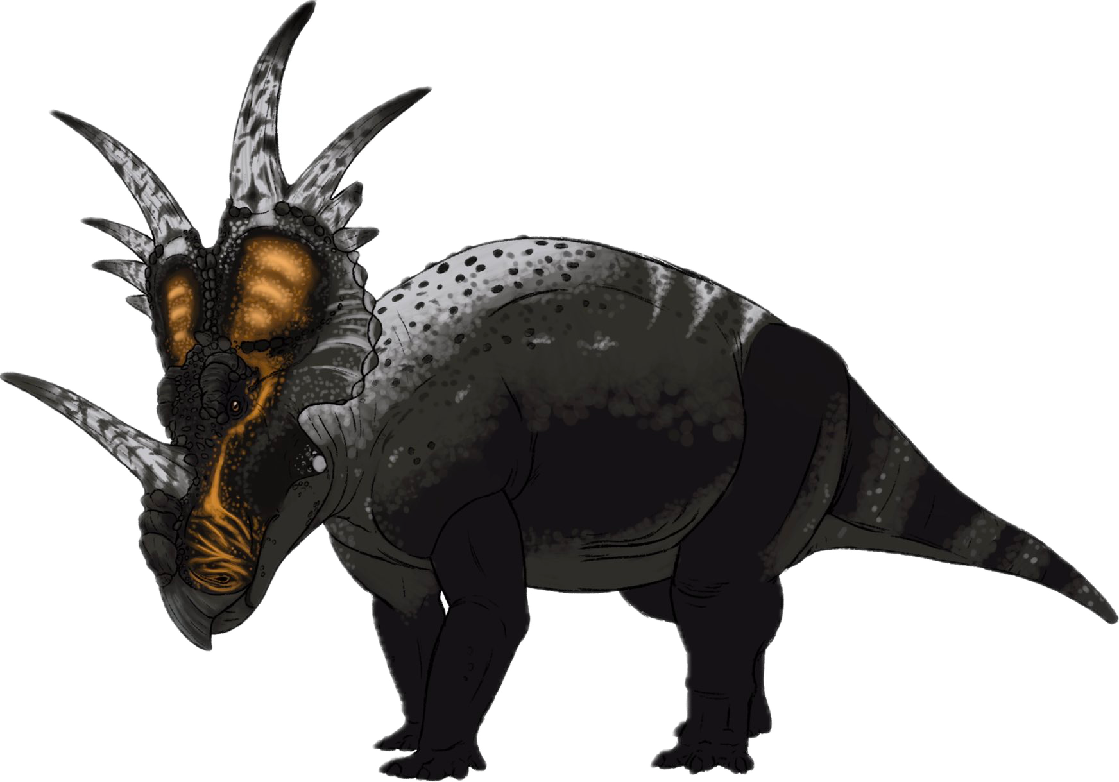
Years 1 and 3
Rodel et al (2024)
Notes:
This is from paper 1. Highlight how agreement becomes worse as periods get longer

Slide 10
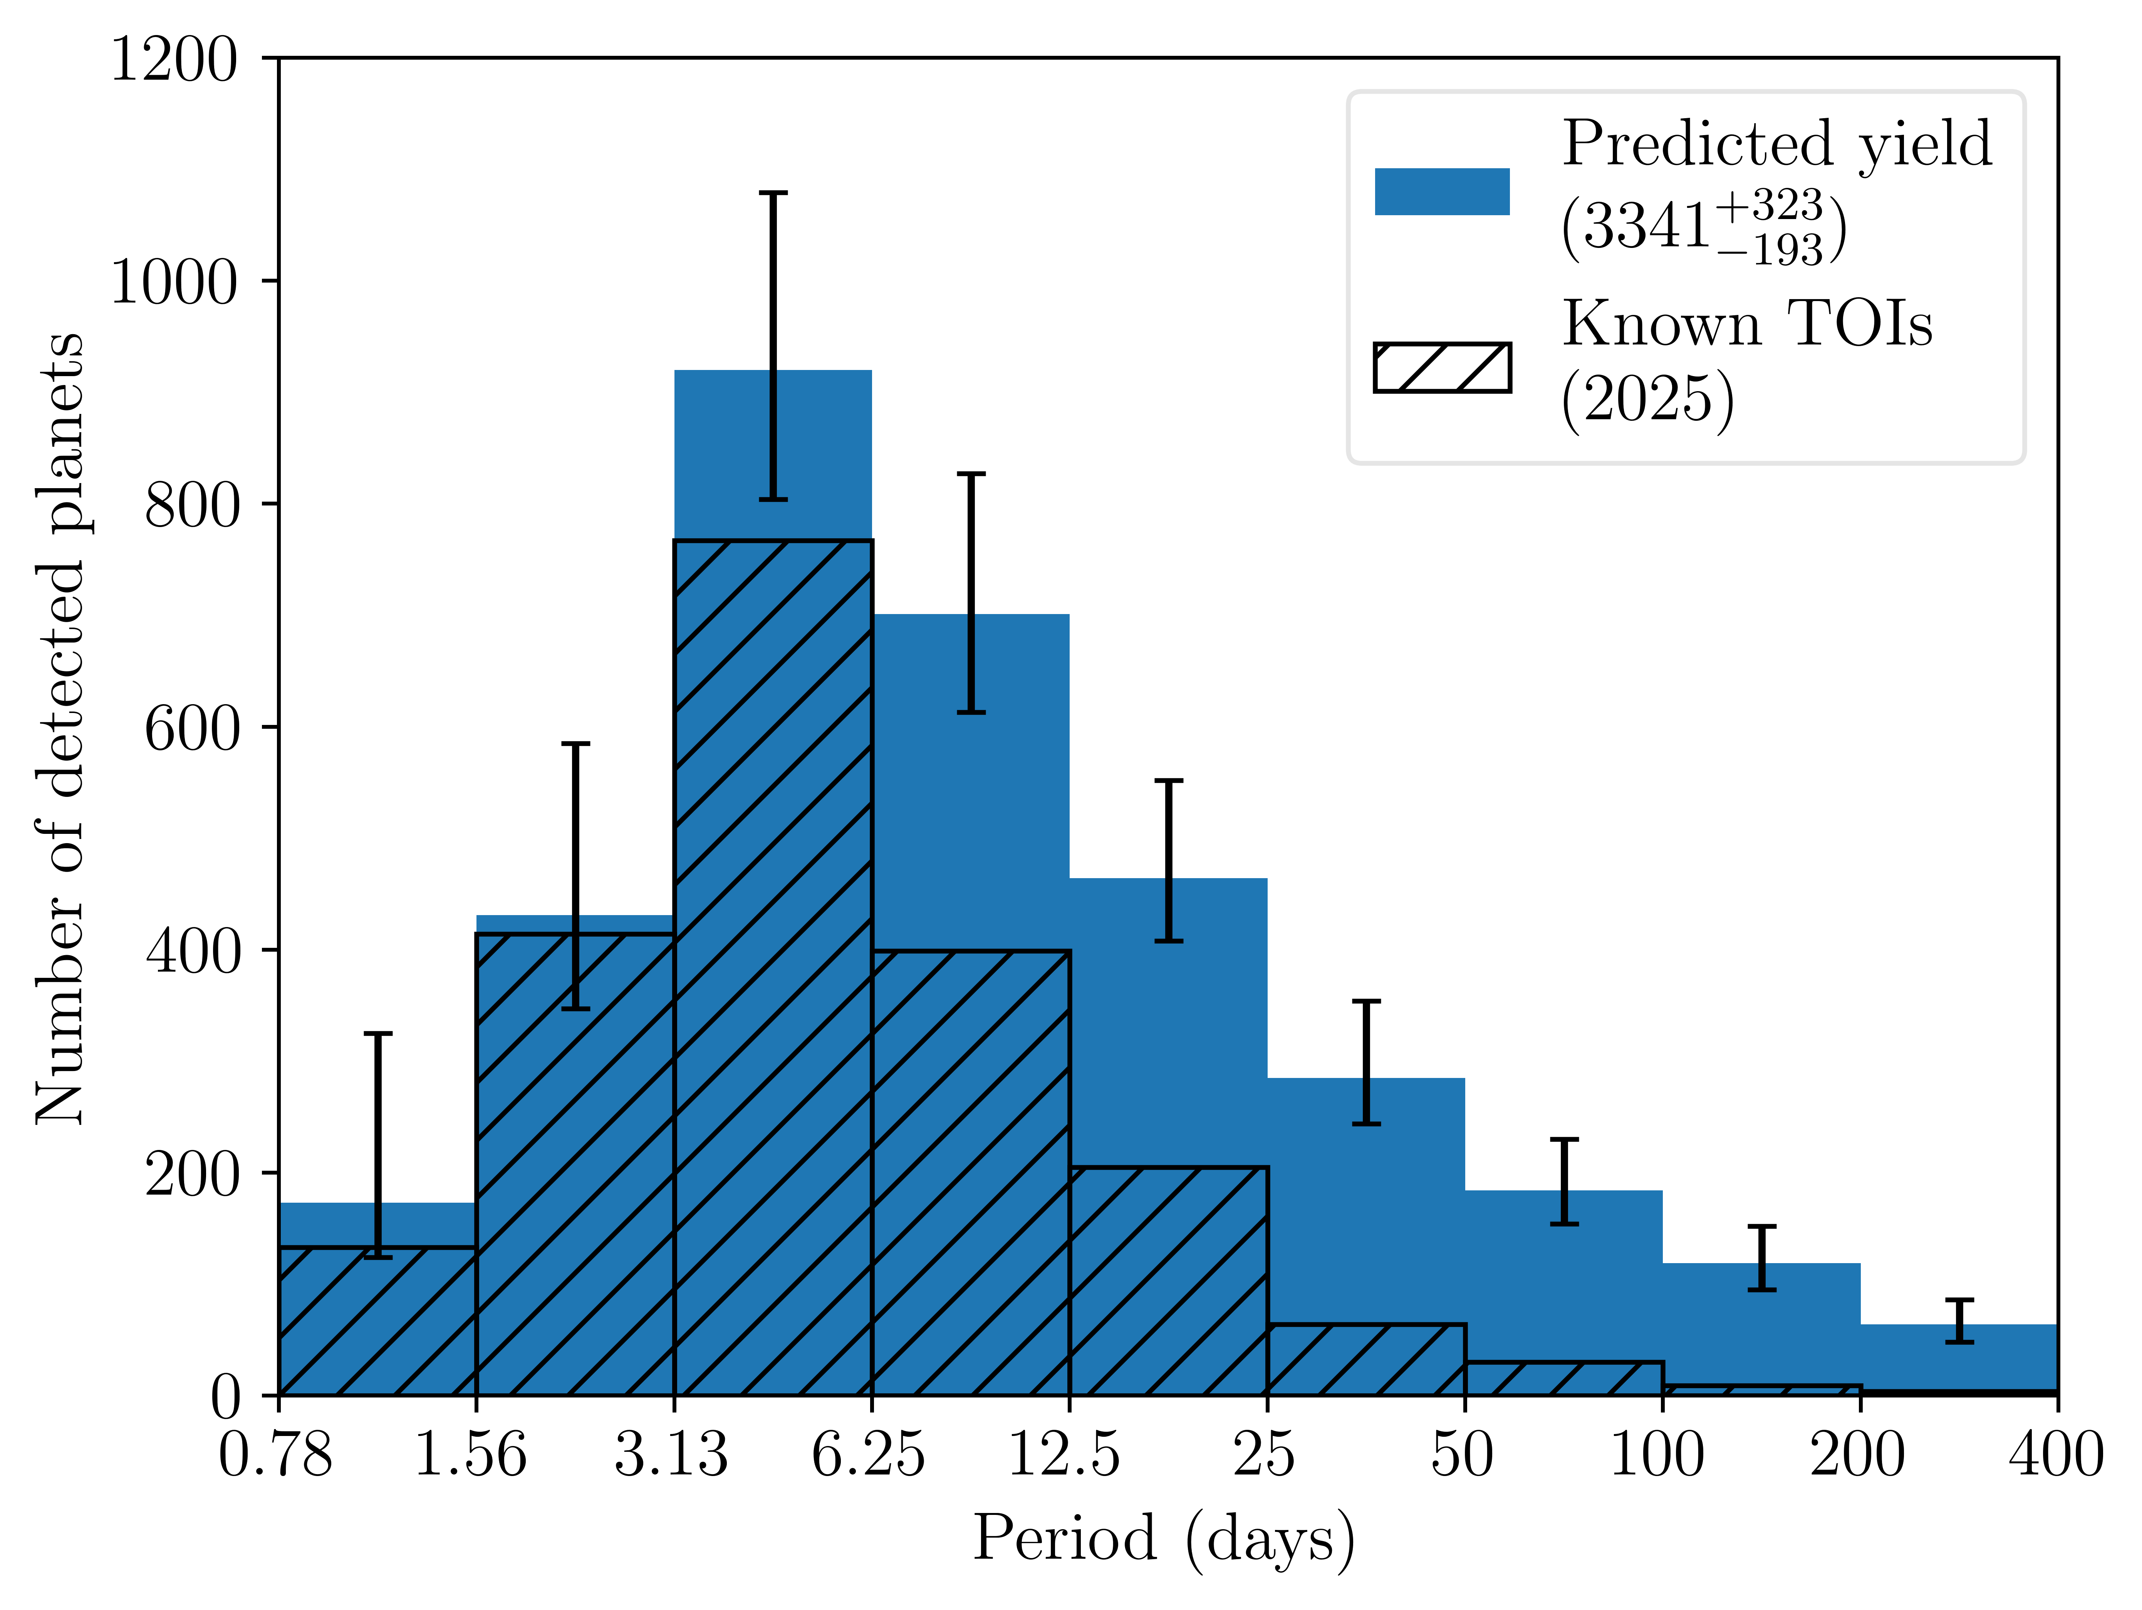
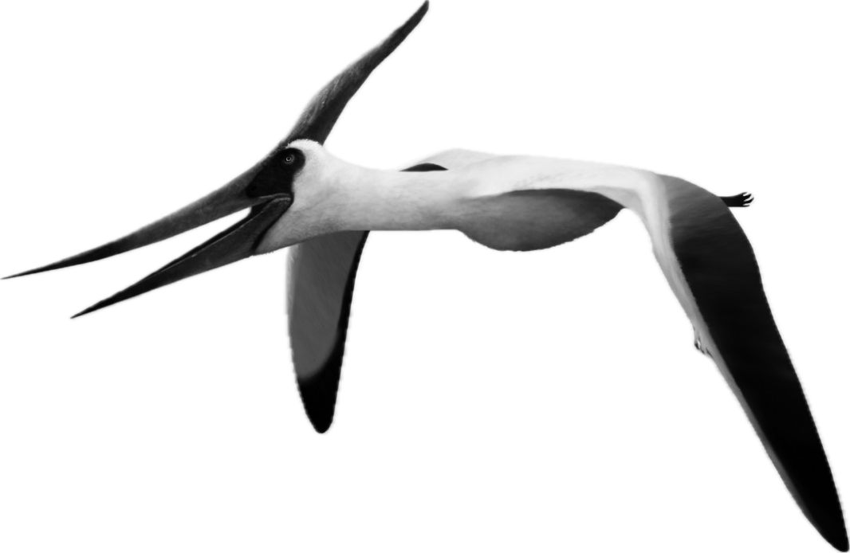
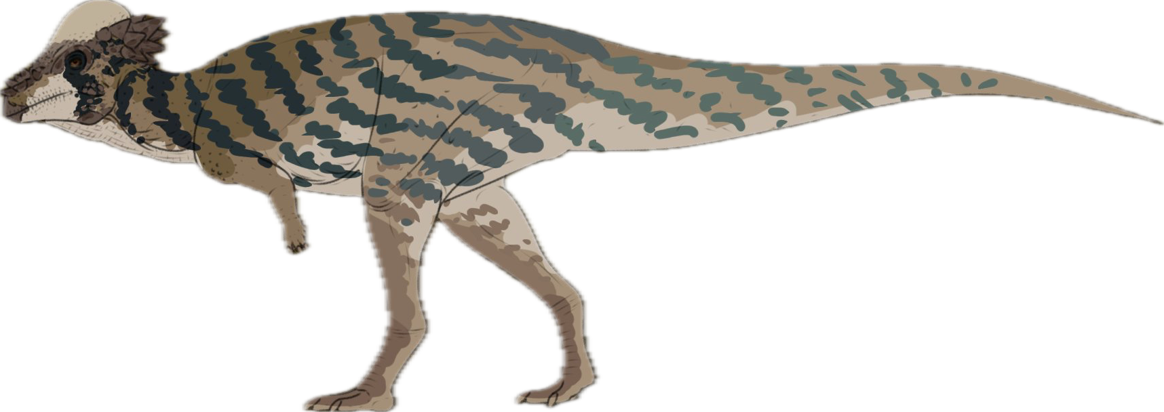
Years 1, 3 and 5
Rodel et al (in prep)
Notes:
With year 5 added. All around improvement, especially in longer periods. Defecit becomes larger – que next slide

Slide 11
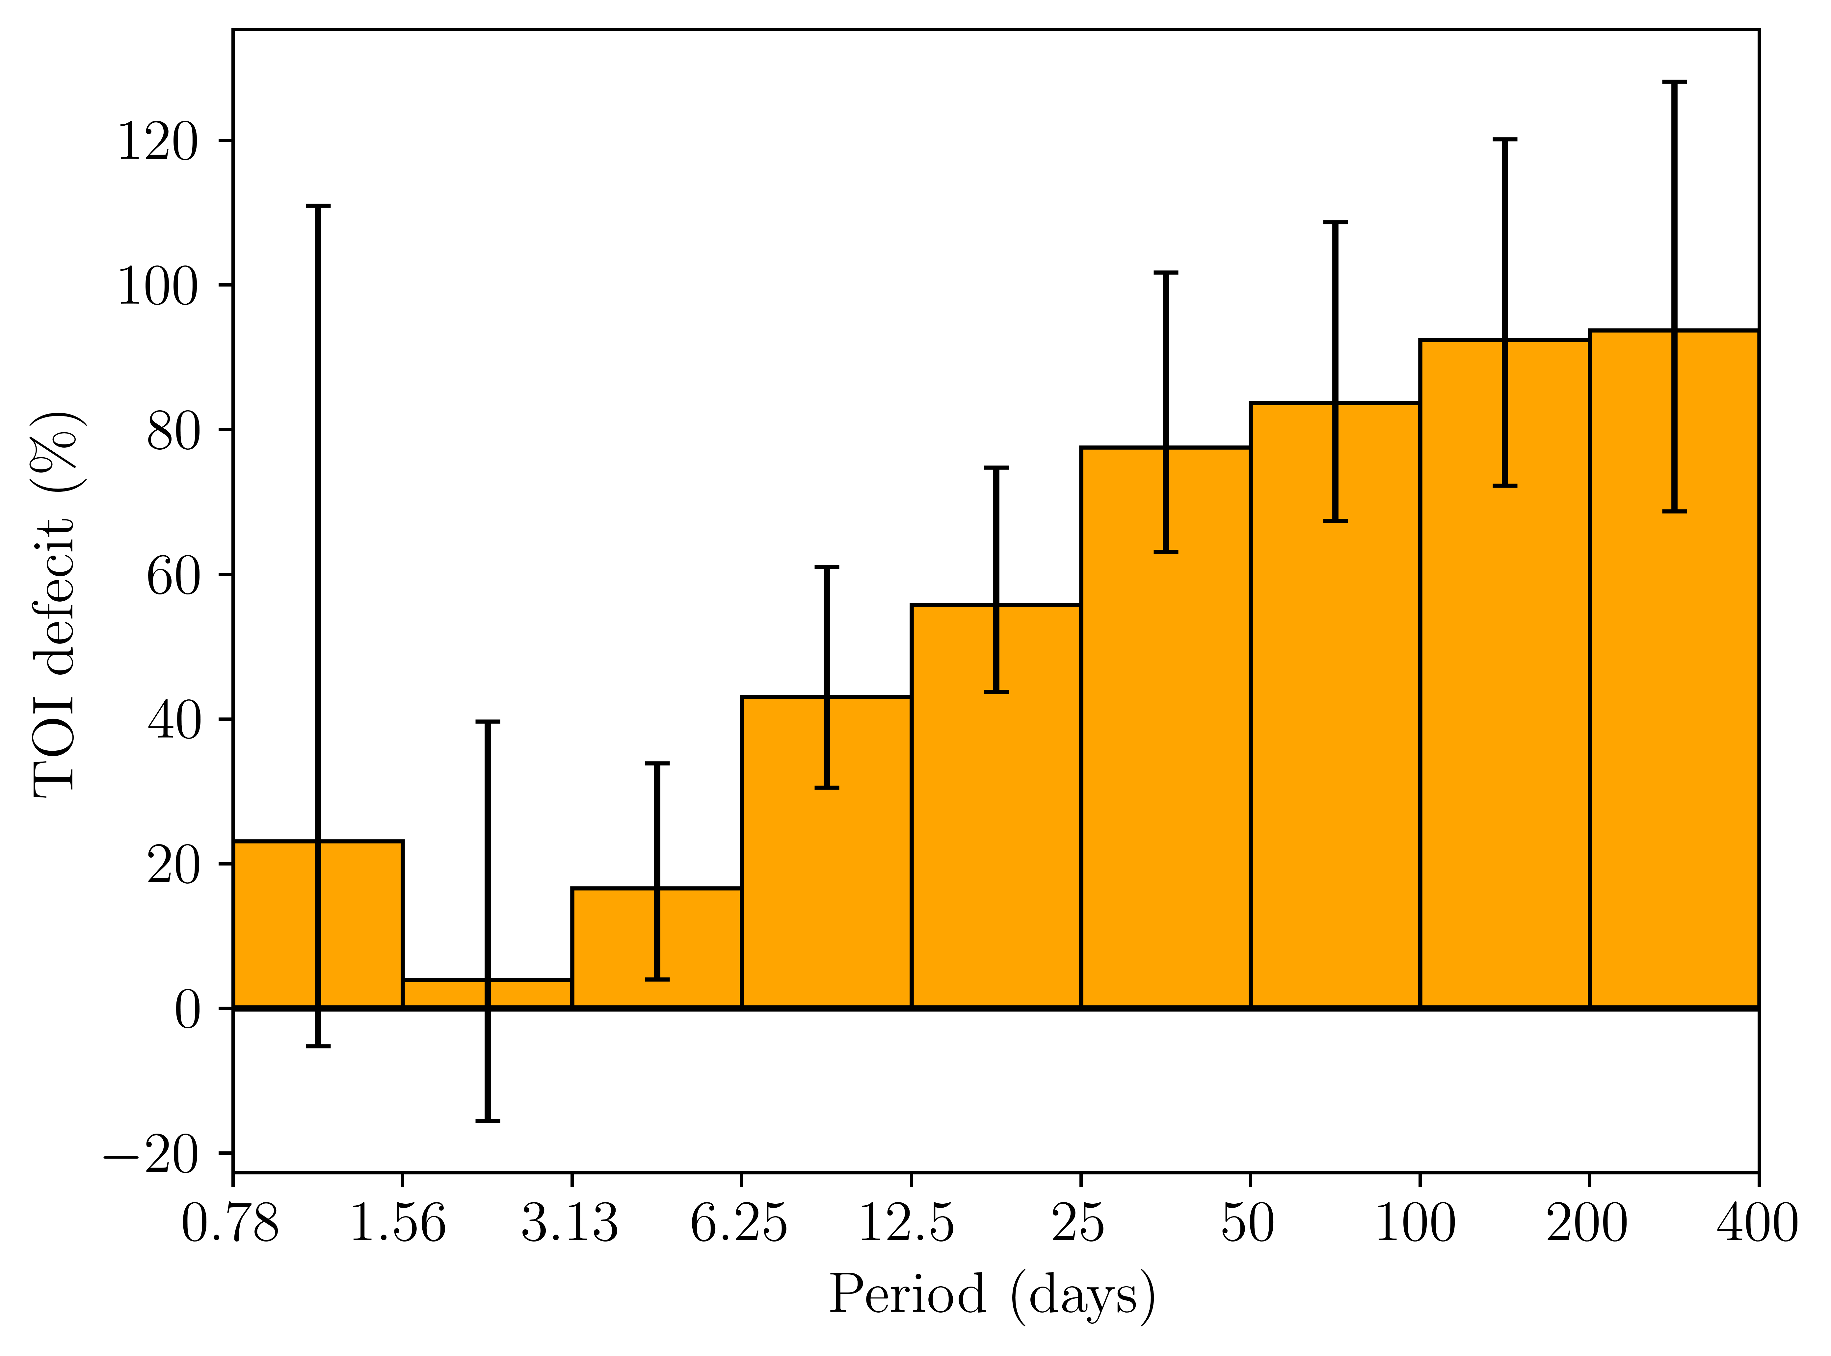
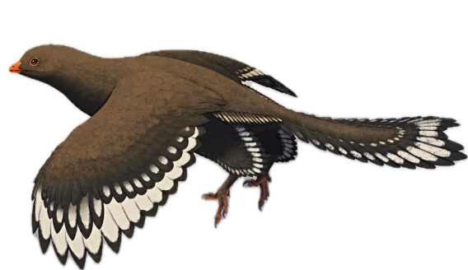
Years 1, 3 and 5
Rodel et al (in prep)
Notes:
Difference becomes more significant once we get beyond a TESS sector. Where are these planets hiding or are we wrong.

Slide 12
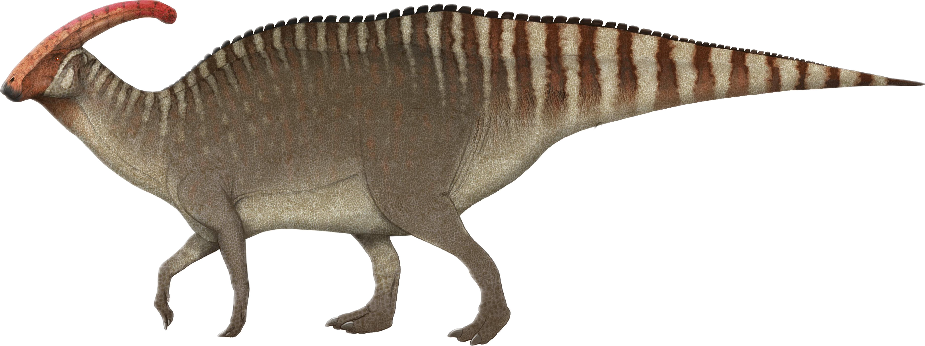
Years 1, 3 and 5
Rodel et al (in prep)
Notes:
Go back to earlier plot, then say what if we remove multis

Slide 13
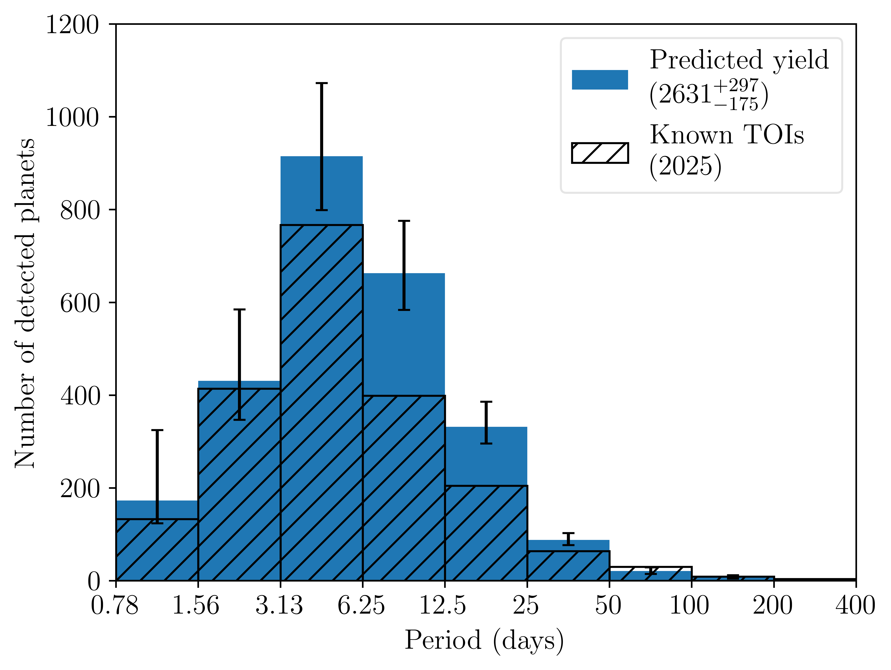
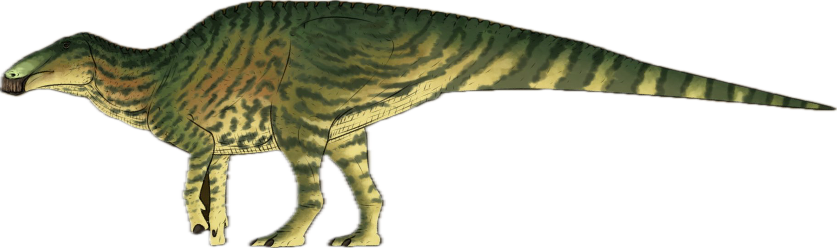
Years 1, 3 and 5
Rodel et al (in prep)
N<4 transits removed
Notes:
Here’s the result. Post 25d defecit effectively dissapears

Slide 14
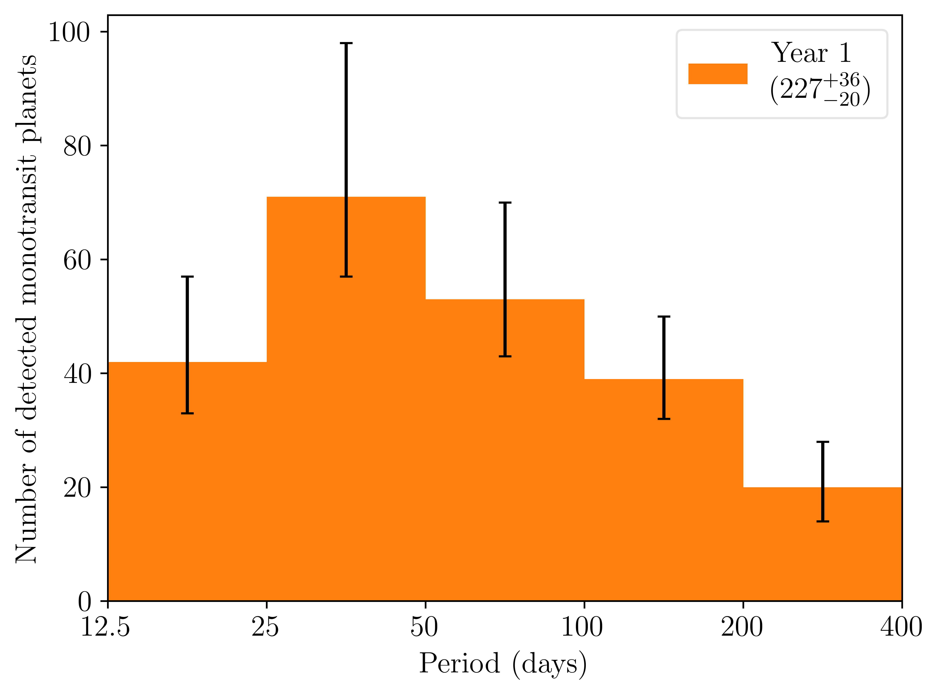
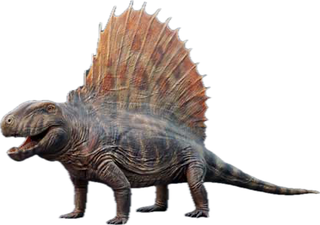
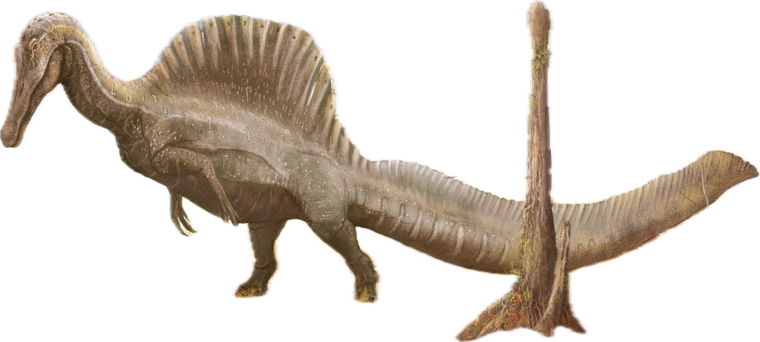
Year 1
Monotransits
Rodel et al (2024)
Notes:
Most of these will be monos. Then introduce how the distribution changes and flick back and forth. TESS is not solving these itself

Slide 15
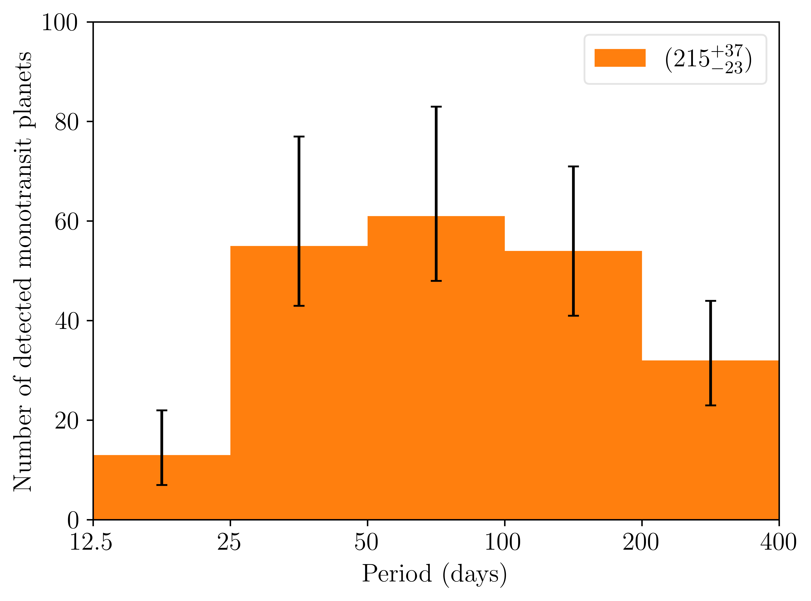
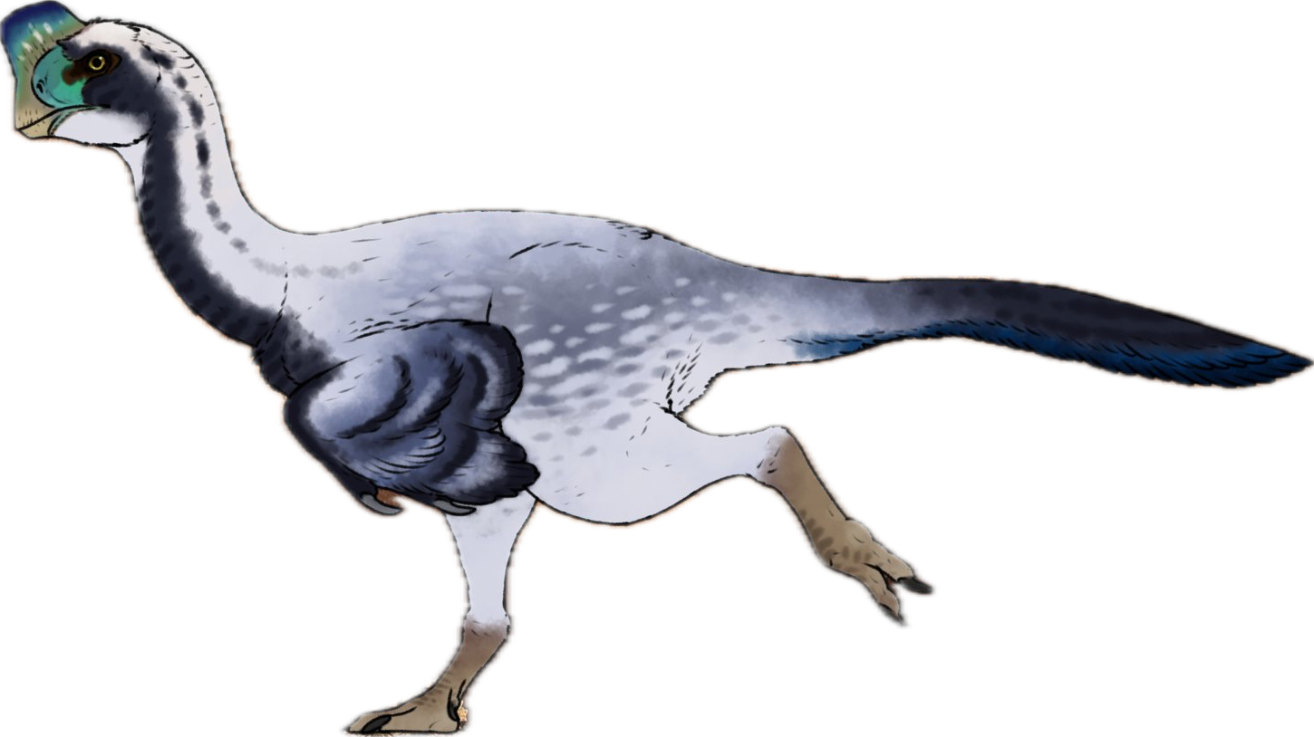
Years 1 and 3
Monotransits
Rodel et al (2024)
Notes:
Don’t linger here

Slide 16
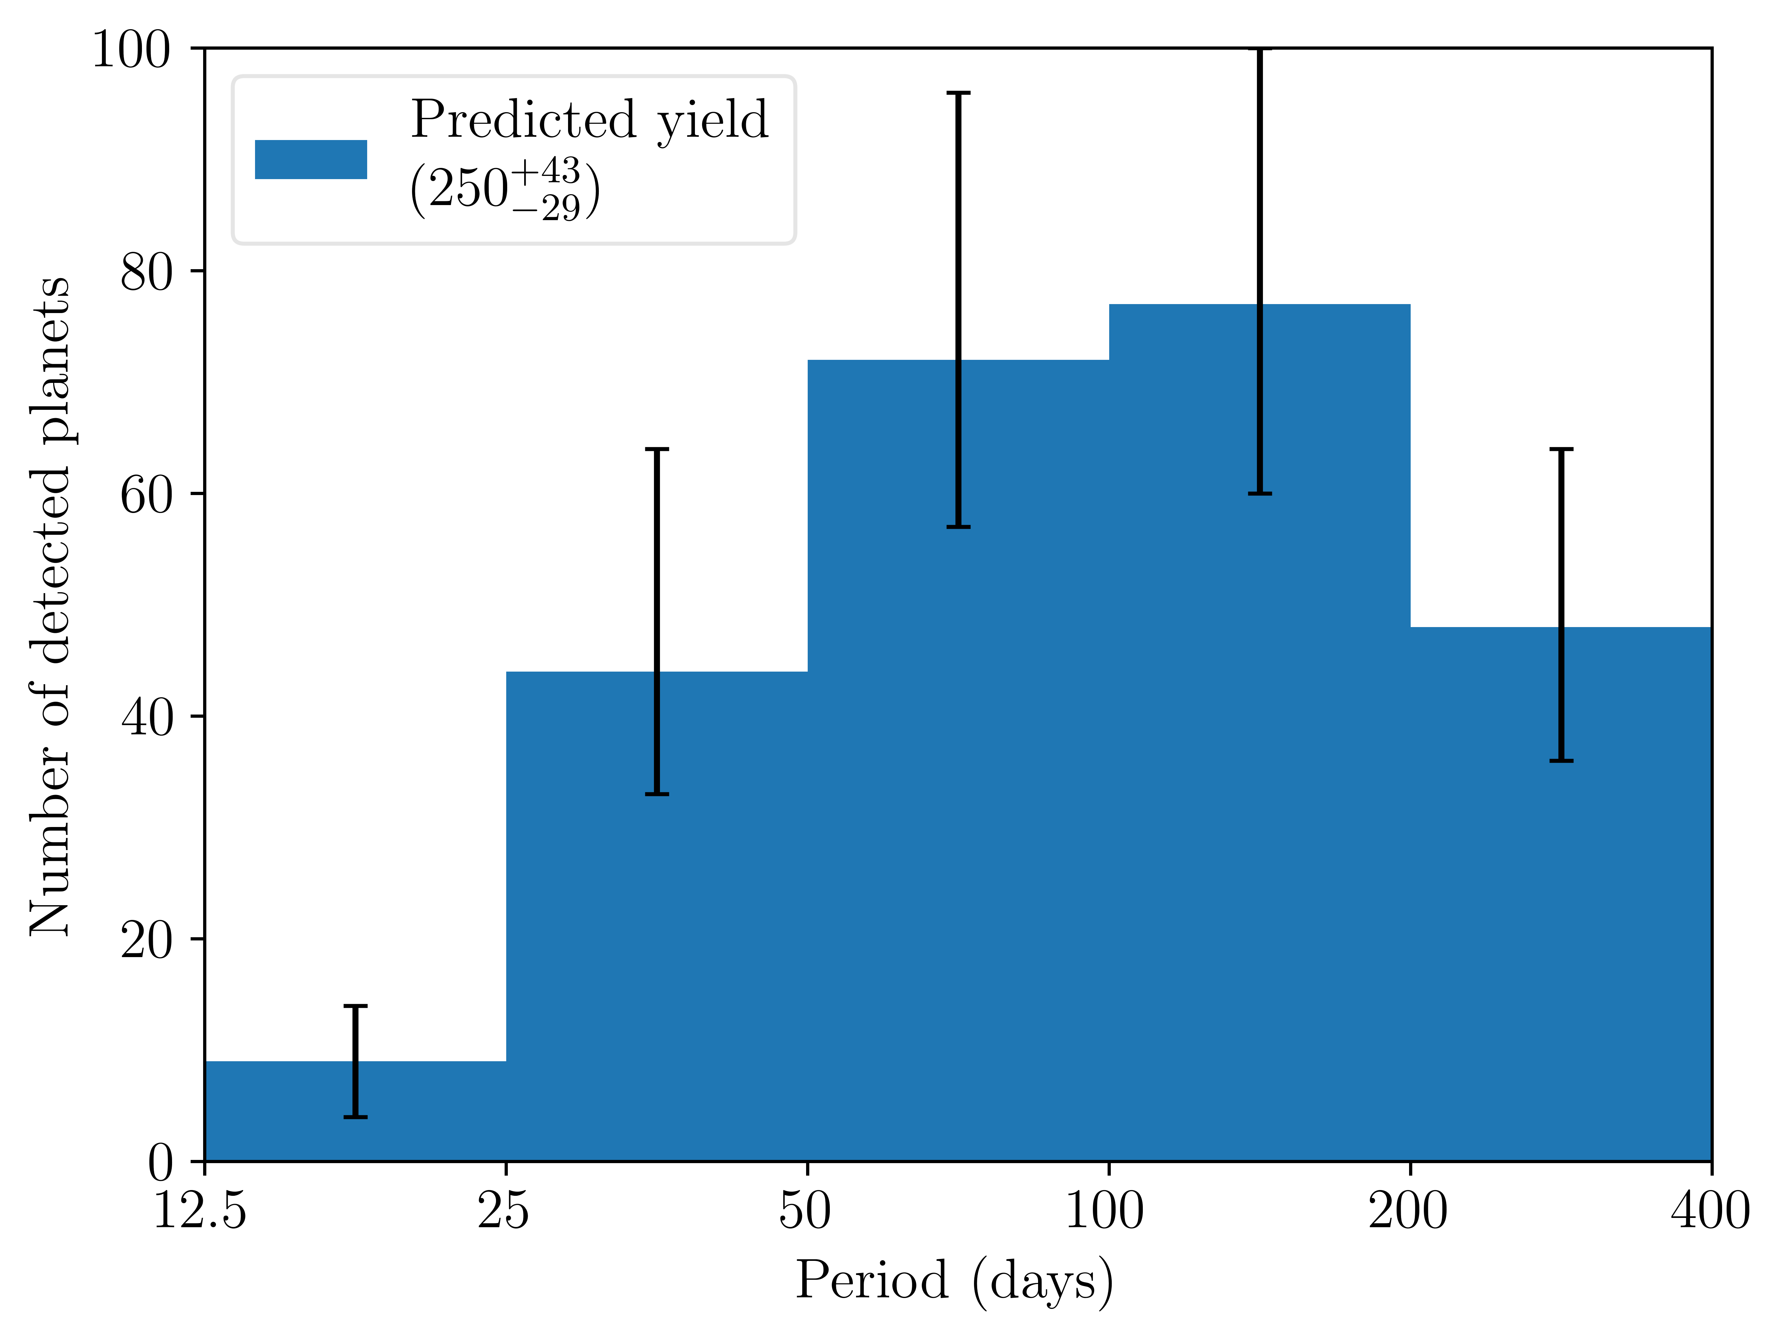
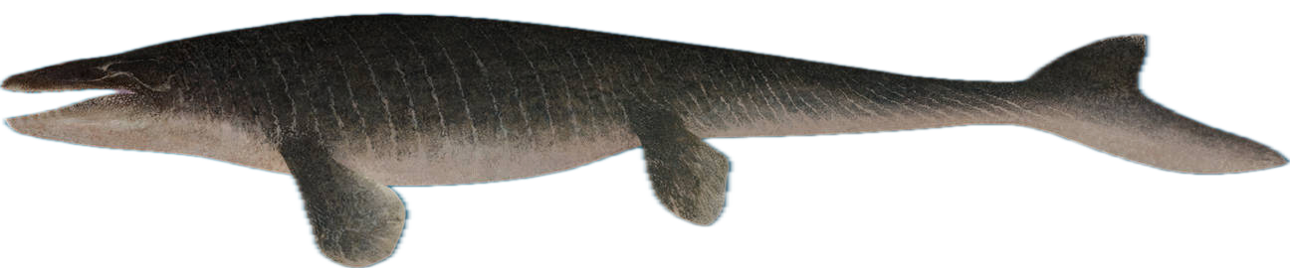
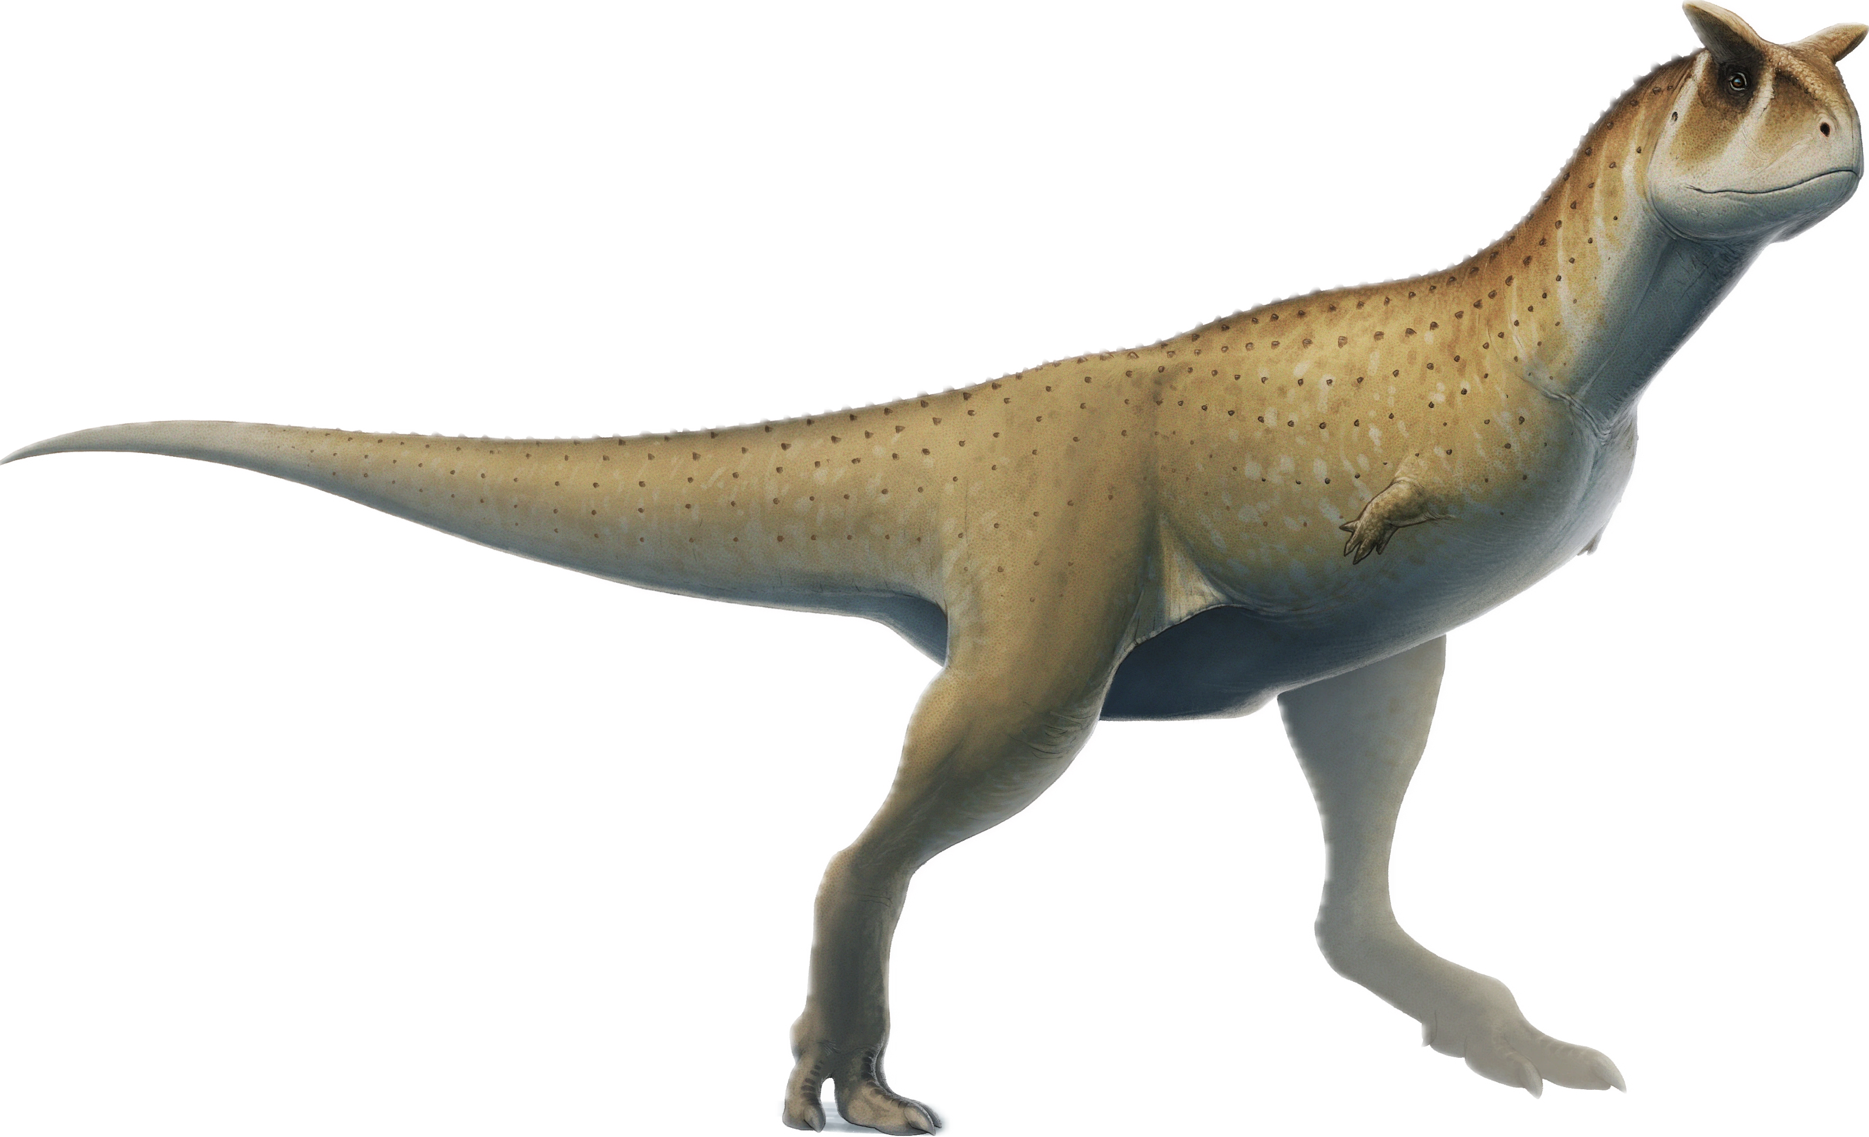
Years 1, 3 and 5
Monotransits
Rodel et al (in prep)
Notes:
Blue so the mosasaur can swim. We’re not hitting the upper period limit yet!

Slide 17
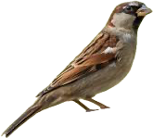
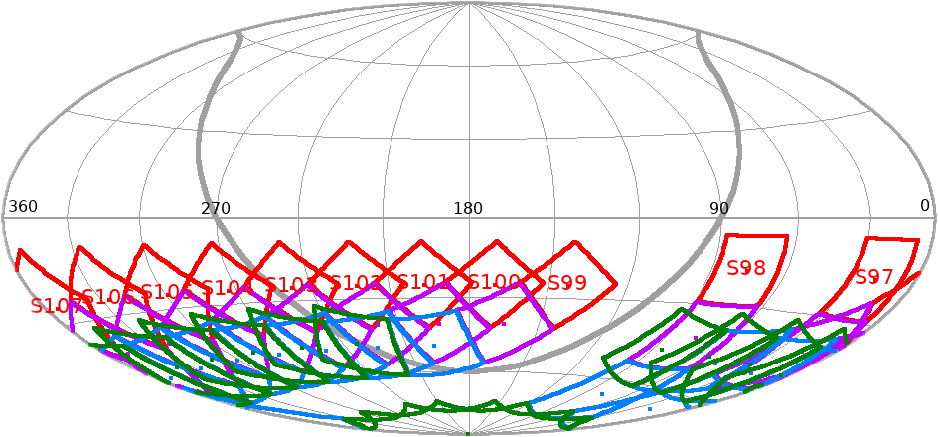
Conclusions:
What’s next?
Expanding to QLP from TESS-SPOC will more than triple our stellar sample.
Predicting yields from different possible future pointings.
Stay tuned for TIaRA TESS 2 later this year (hopefully)!
Rodel et al (2024)
Notes:
Leave here. Tell people the North and ecliptic spoc will be in the paper as well as QLP. Then introduce potential pointing comparison paper.

Slide 18
Dinosaur answers*
*Not to scale
14. Dimetrodon (Not a dinosaur!)
14. Spinosaurus
1.Tyrannosaurus rex
9. Styracosaurus
2. Triceratops
10. Pteranodon (Not a dinosaur!)
15. Oviraptor
3. Velociraptor
16. Mosasaurus (Not a dinosaur!)
4. Stegosaurus
10. Pachycephalosaurus
5. Ankylosaurus
11. Archeopteryx
16. Carnotaurus
6. Brachiosaurus
12. Parasaurolophus
17. Passer domesticus
(Old world house sparrow, a dinosaur)
7. Coelophysis
(NM state dino!)
13. Edmontosaurus
8. Allosaurus

Slide 19
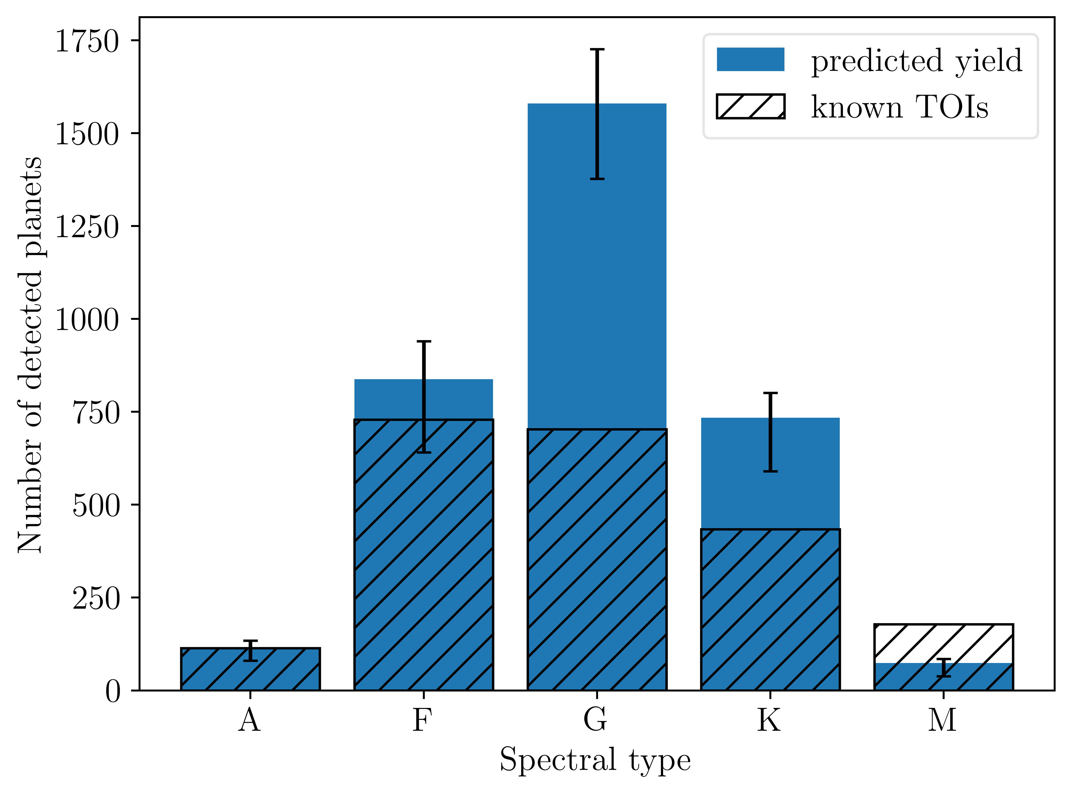
Rodel et al (in prep)

Slide 20
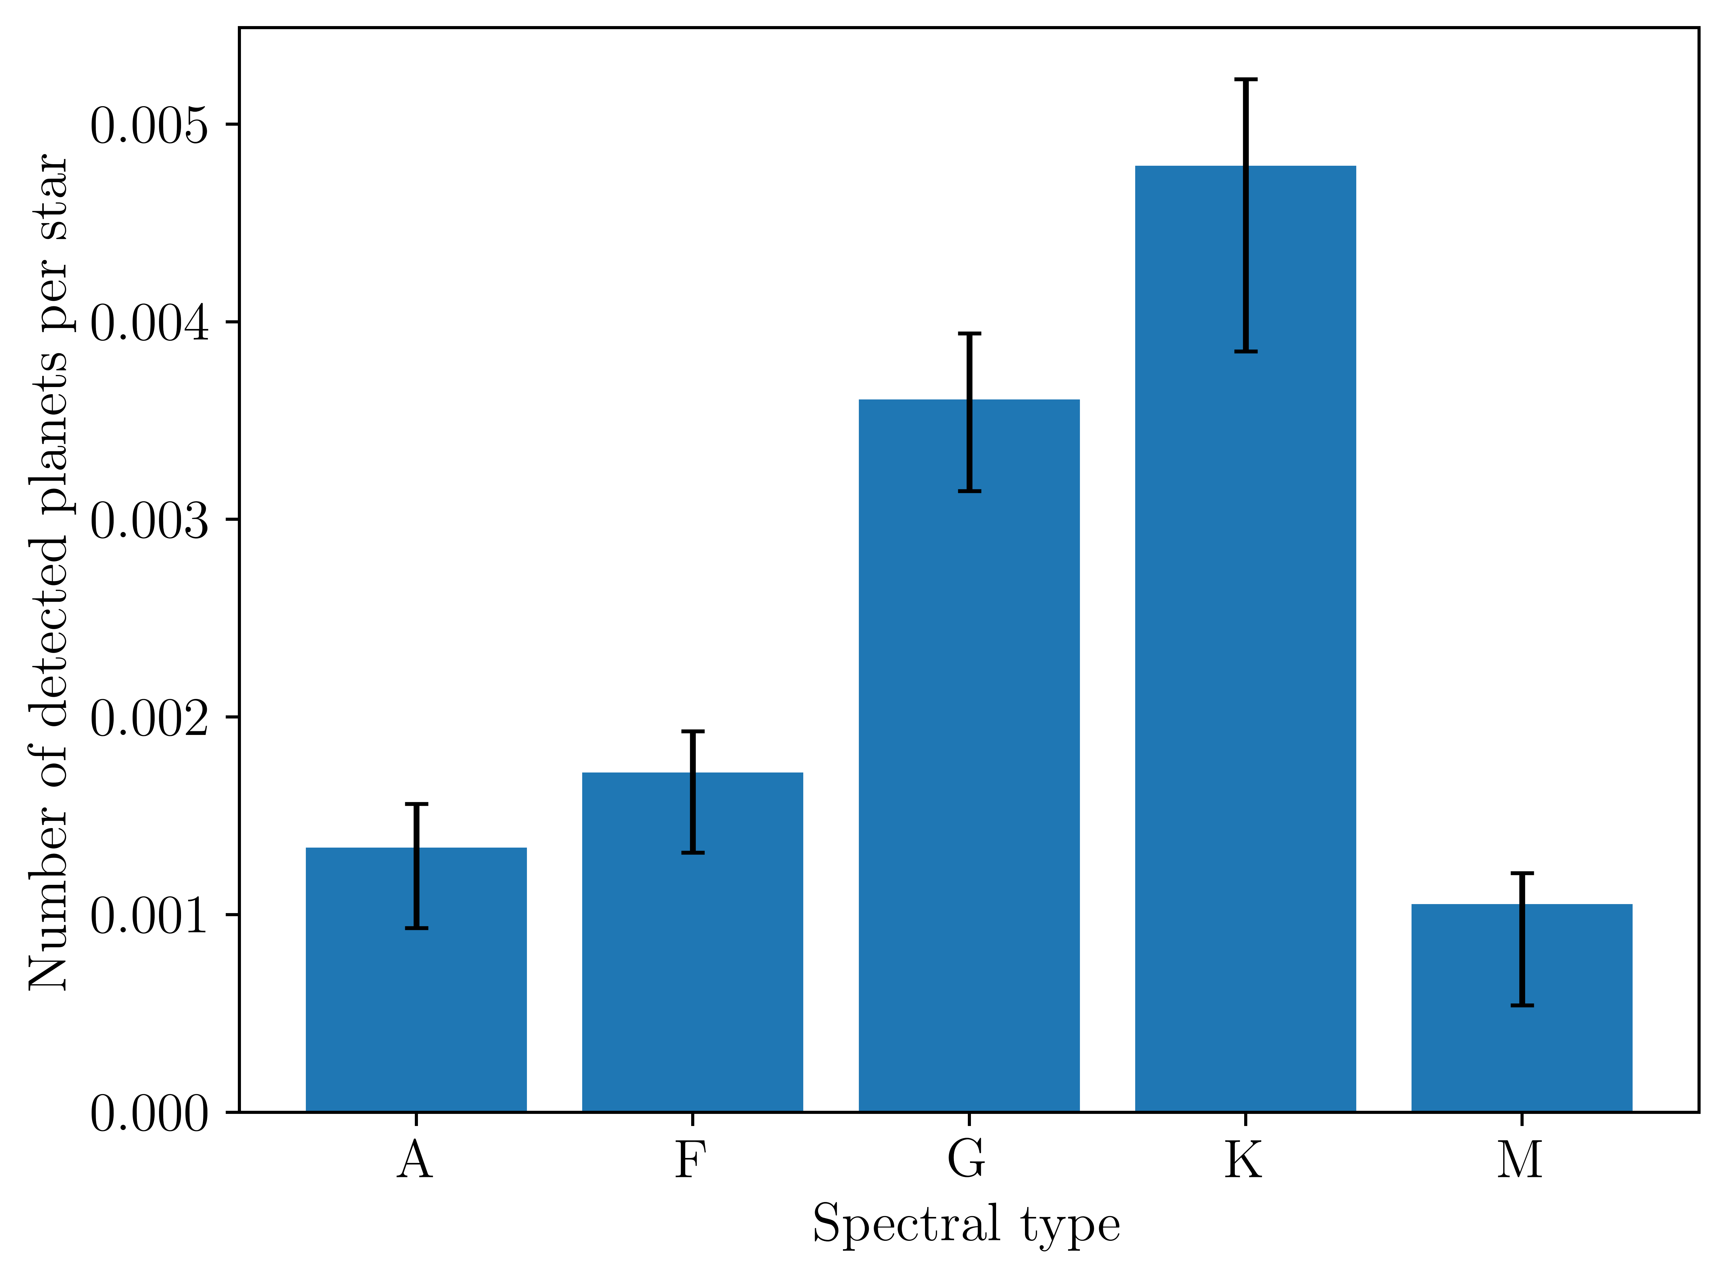
Rodel et al (in prep)
Notes:
Normalised yields. Slam the brakes on the M dwarf hype train

Slide 21
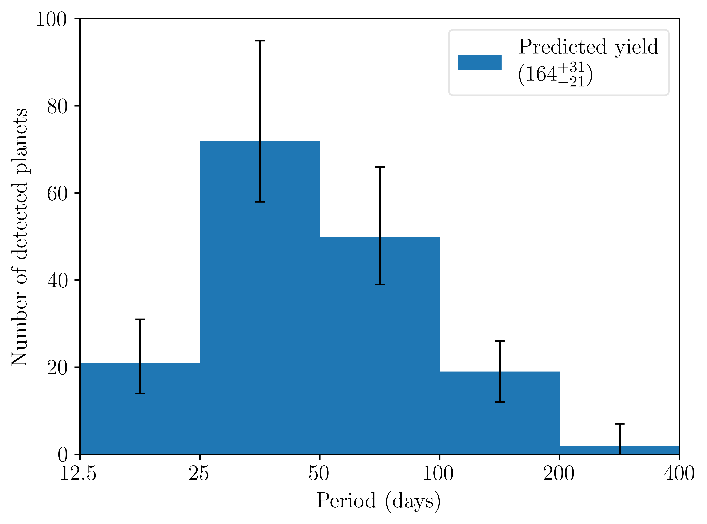
Duos
Rodel et al (in prep)
Notes:
Duos where sectors/transits are not consecutive!

Slide 22
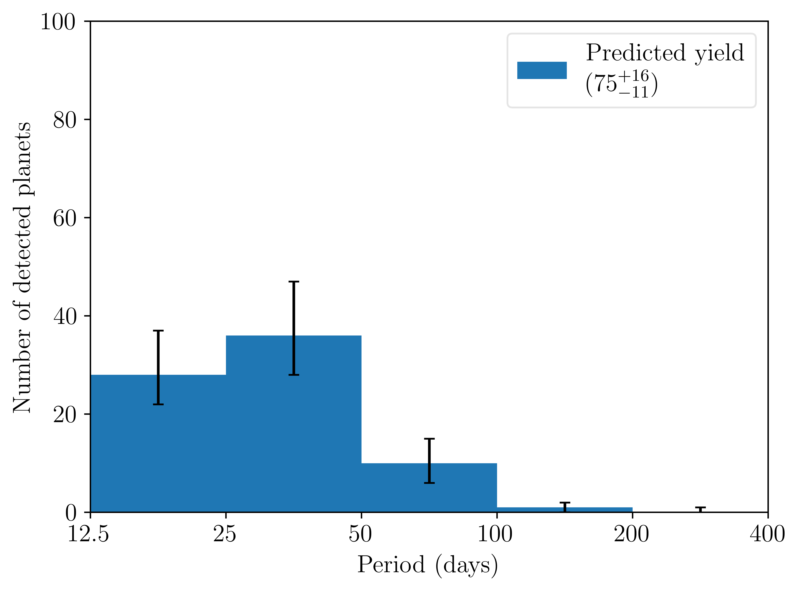
Trios
Rodel et al (in prep)
Notes:
Trios where sectors/transits are not consecutive!

